Slide 1

The
Communication
Process
4 Videos
26 Slides
20 Word Wall
Posters
Created by: Not Just for Elementary

Slide 2
The
Communication
Process
https://www.youtube.com/watch?v=rDkxsNmKDGk

Slide 3
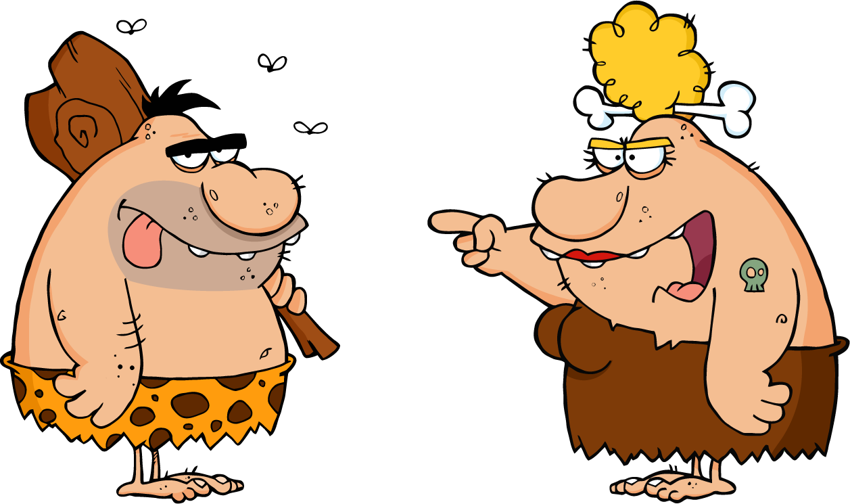
Communication
The process of creating and exchanging meaning through symbols

Slide 4

Why do we communicate?

Slide 5
Self
Actualization
Ego/Esteem:
Appreciation, feeling good
Belonging:
Family & friends
Safety:
physical, financial, and emotional
Physical:
Food, Water, Shelter, sleep

Slide 6

Maslow’s Hierarchy of Needs
https://www.youtube.com/watch?v=Iucf76E-R2s

Slide 7
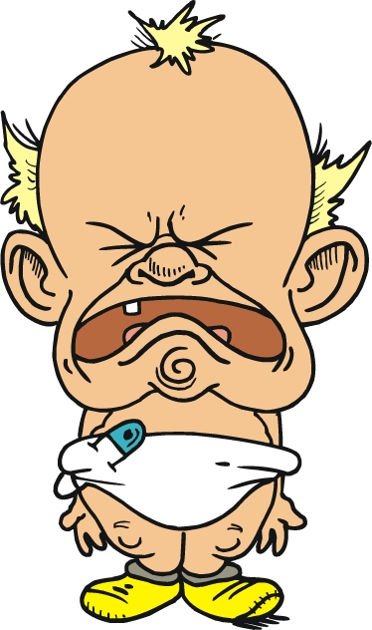
To express feelings
and emotions

Slide 8

To persuade or control

Slide 9

To relate with others

Slide 10
To participate in social
rituals

Slide 11
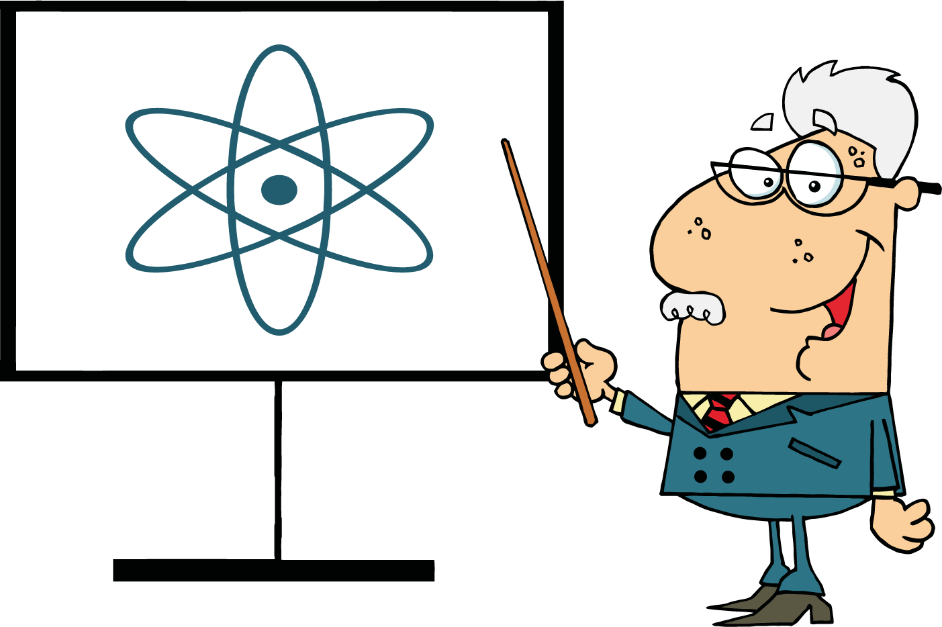
To inform

Slide 12

5
Characteristics of Communication

Slide 13

Learned
Communication is learned
because we become better communicators over time through practice and experiences.

Slide 14
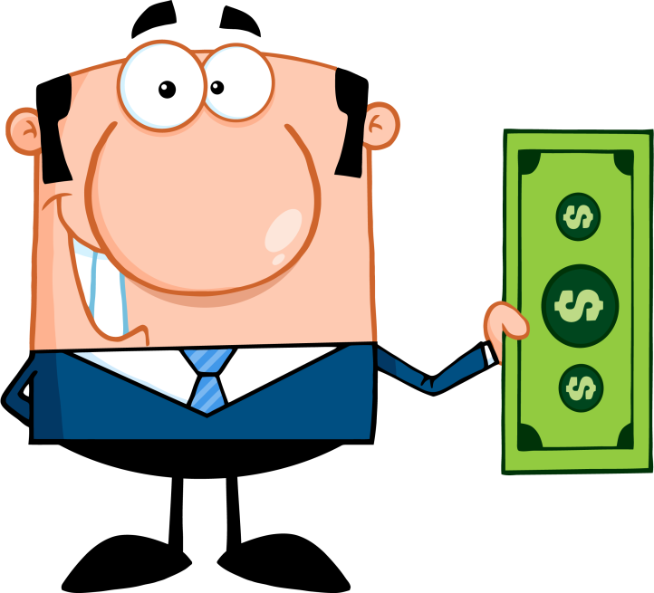
Transactional
Communication is transactional because it involves an exchange.
In other words:
You have to give and receive for communication to happen.

Slide 15

Unavoidable
Communication is unavoidable because it is impossible to not communicate.
You communicate through your appearance, body language, words, tone, actions, and more!

Slide 16

Continuous
Communication is continuous because relationships are influenced and reshaped by each interaction.
Have you ever:
gotten a bad first impression of someone?
overcome someone’s negative opinion of you?
changed your view of someone based on their actions?

Slide 17
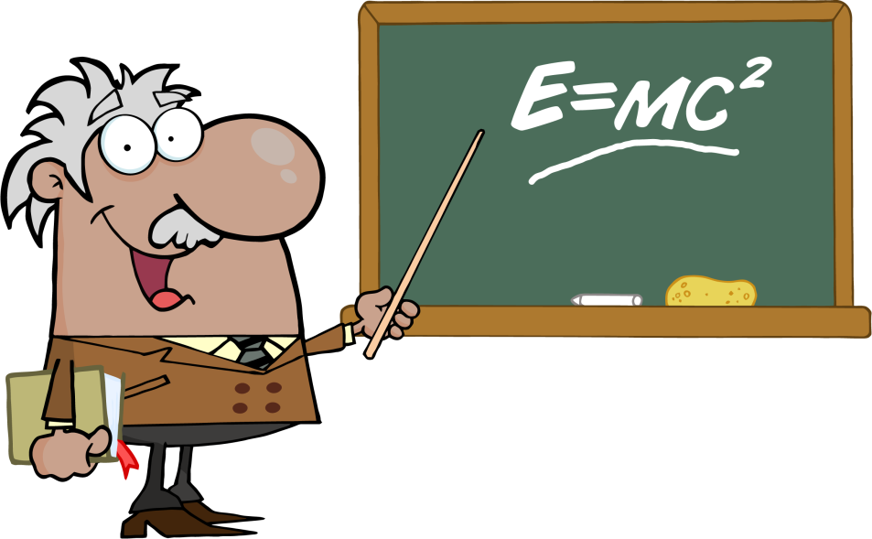
Complex
Communication is complex because it’s…
Symbolic
Cultural
Irreversible
Circular
Purposeful
Impossible to duplicate
http://youtu.be/ef_wu8BnCjs

Slide 18

Symbolic
Communication is open to the receiver’s interpretation

Slide 19

Cultural
Cultures add different and new meanings to words, phrases, and actions.

Slide 20

Irreversible
Once communication is sent, it can’t be taken back.

Slide 21
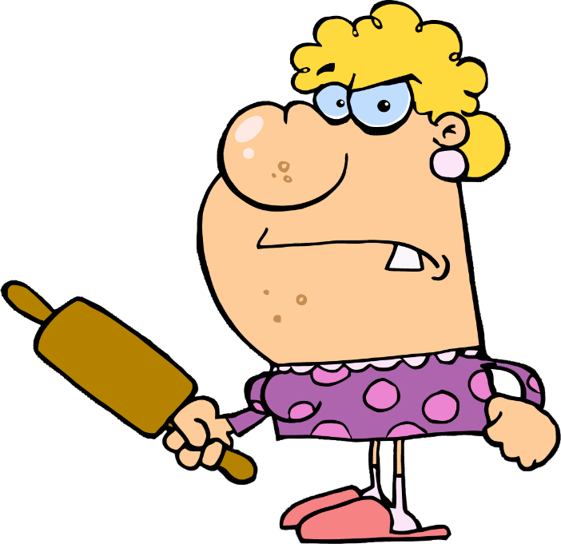

circular
All communication has both a
message and feedback.

Slide 22
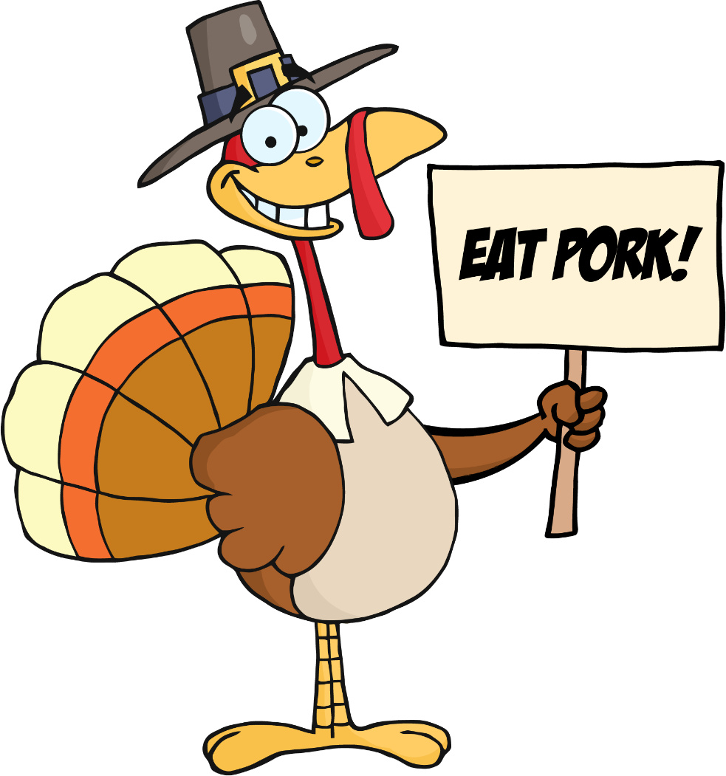
Purposeful
There is always a reason behind
a message.

Slide 23

Impossible to duplicate
Each interaction is unique.

Slide 24

The Communication Process
https://www.youtube.com/watch?v=7di5zAMMxaI

Slide 25
Sender- sends message
Encoding- the intended message
Channel- how/where message is delivered
Barrier- blocks message
Message- what is actually communicated
Feedback- message sent by receiver
Noise- interferes with message
Channel- how/where message is delivered
Decoding- how the receiver interprets message
Receiver- receives message

Slide 26
Teacher
I need students to know that there is a test on Friday.
Verbally, in class
Fire alarm prevents message
“We will have a test on Friday.”
Abby asks “what do I need to study?”
Loud class
Verbally, in class
“I wonder what will be on the test…”
Students

